Slide 1
SimBA: Black box attacks on Image classifiers
Team 33: Ardhendu Banerjee (2022201005) Animesh Das (2022201027)
Ritvik Gupta (2022202005)
Paper Link: Simple Black-box Adversarial Attacks (arxiv.org)

Slide 2
The problem
Paper
Problem Statement
Experiment Setup
Simple Black Box adversarial attacks Chuan Guo, Jacob R. Gardner, Yurong You, Andrew Gordon Wilson, Kilian Q. Weinberger. 2019.
Try to make pretrained state of the art classifiers on Imagenet to misclassify data, using as less queries as possible in a black box fashion.
Experiments on a subset of Imagenet data (Imagenette) and Tiny Imagenet data with models available through the PyTorch API.

Slide 3
Proposed Solution of the paper
Random Attack
Orthonormal Basis
Query Efficiency
In each attack random pixels are chosen and a channel(color) is chosen at random.
Now value of a chosen channel is changed in such a way so as to propagate the attack (cartesian basis).
Most of the images are misclassified successfully after only 5000 queries (70% success rate, as reported)

Slide 4
Attack Strategy
We perturb the individual channels of a pixel in each iteration by a small amount epsilon. At first we add the value to a random pixel, if the model probability decreases, we set that value else subtract from the value and try again. If the probability still doesn’t change, we choose another random pixel in the next iteration.
Cartesian Basis: a single independent feature of the sample

Slide 5
TinyImageNet experiments: MobileNetV2
Targeted attack with correct mappings, and different strategies
Preliminary: FGSM White Box attacks
1
2
3
4
5
Replication of author’s code with ResNet50 with TinyImageNet
Targeted and untargeted pixel attack comparisons for subset Data

Slide 6
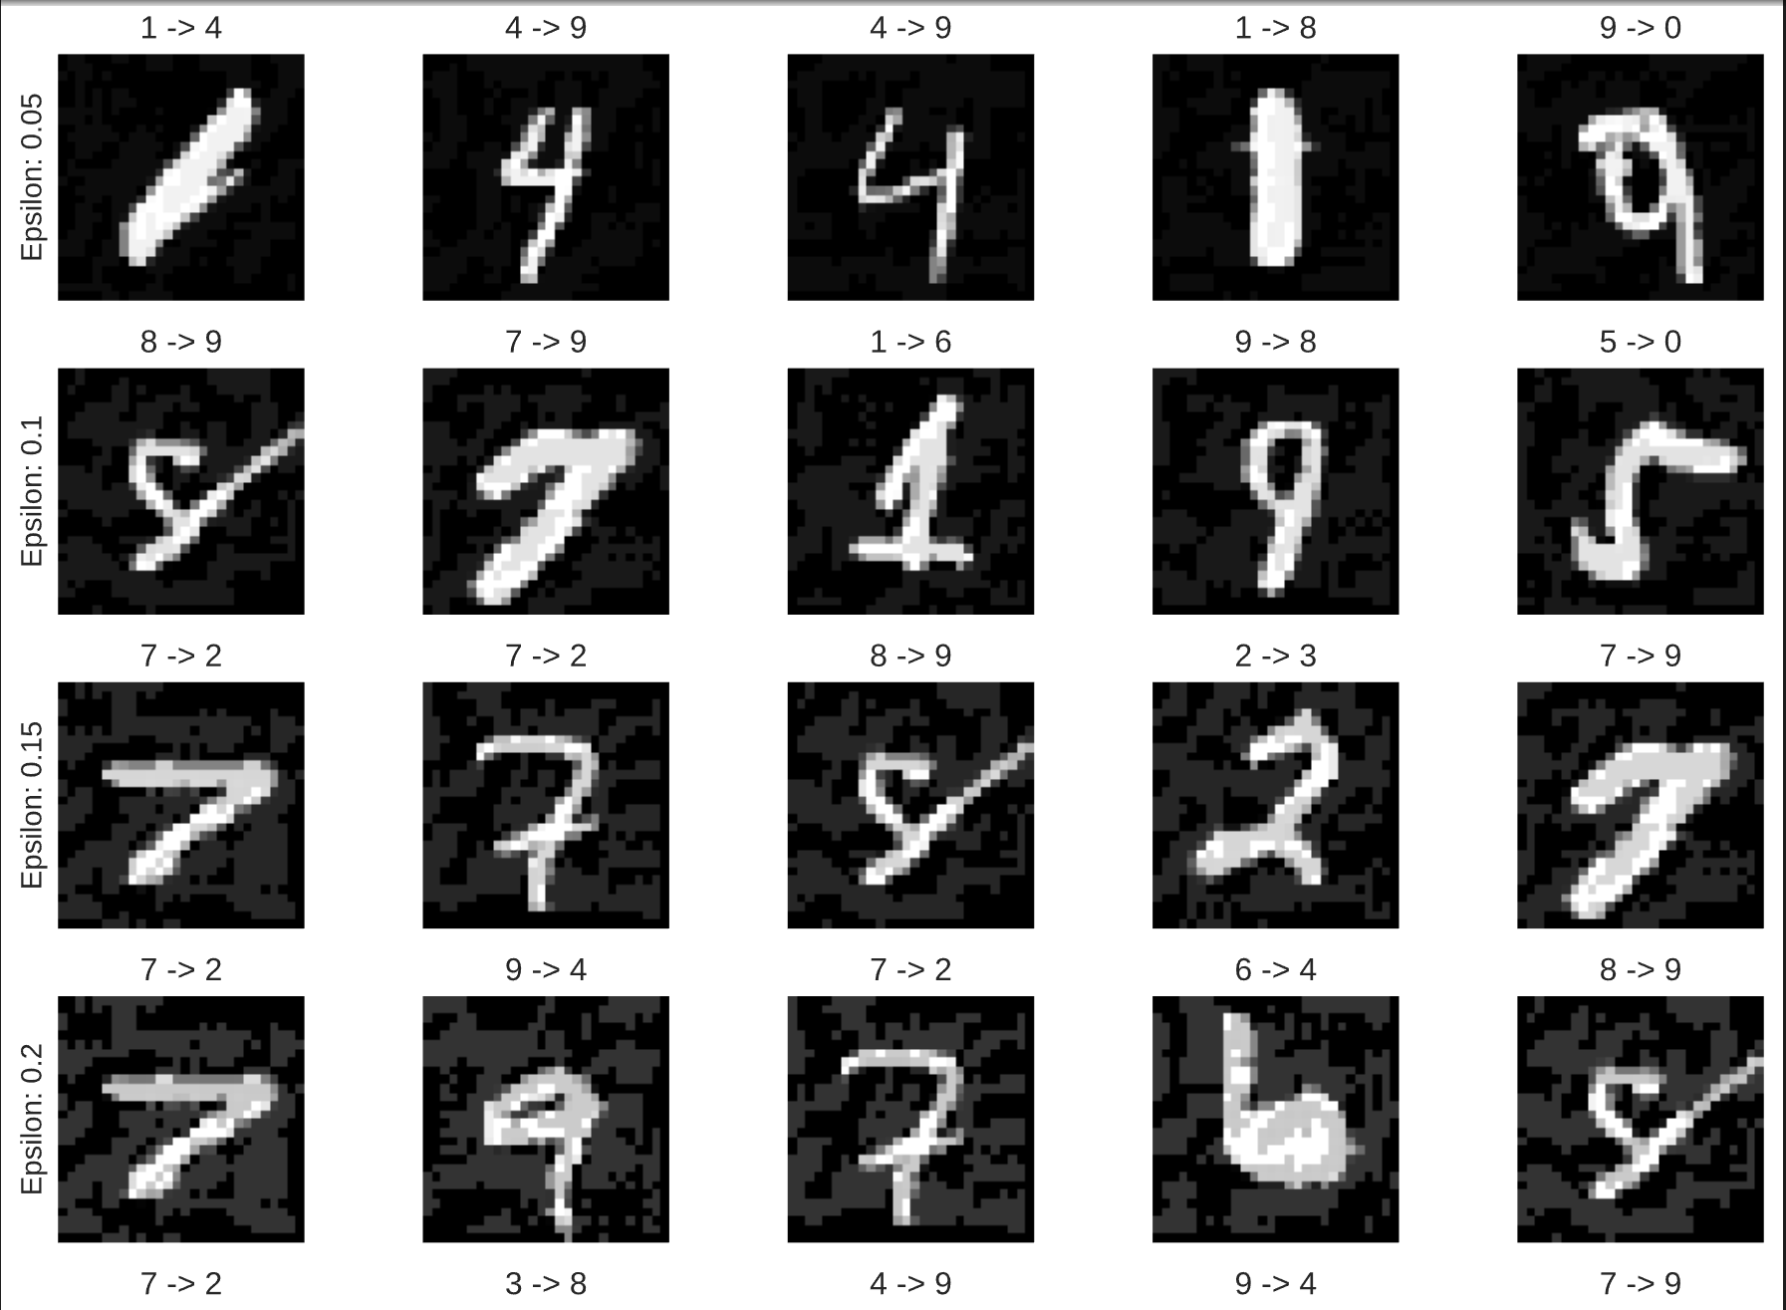
Results

Slide 7
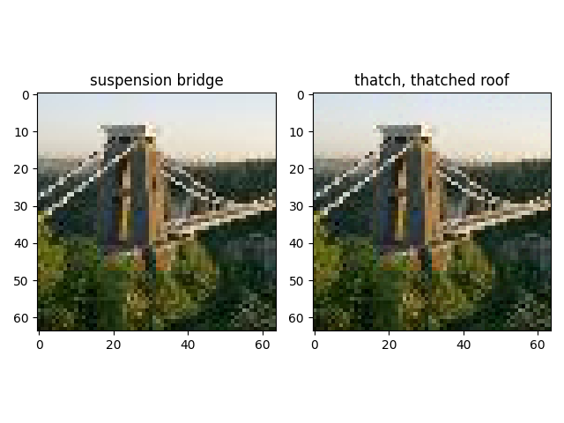
Untargeted attack on Tinyimagenet

Slide 8
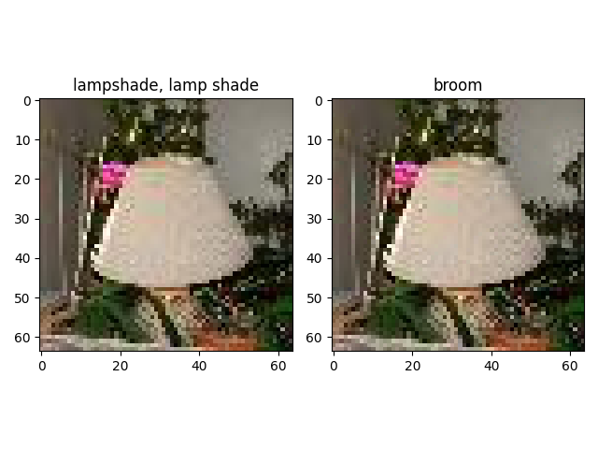
Untargeted attack on Tinyimagenet

Slide 9
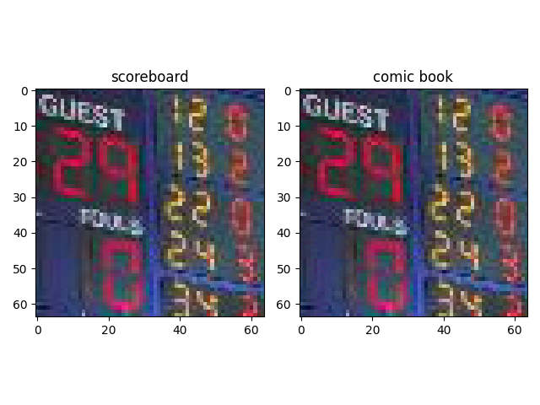
Targeted attack on Tinyimagenet: 5th likely class

Slide 10
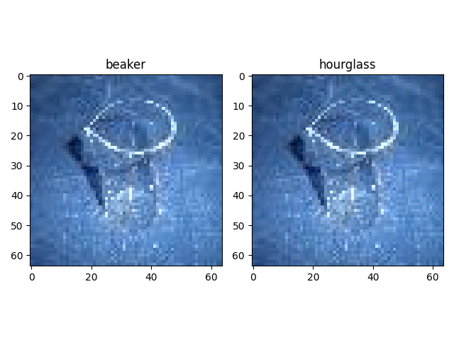
Targeted attack on Tinyimagenet

Slide 11
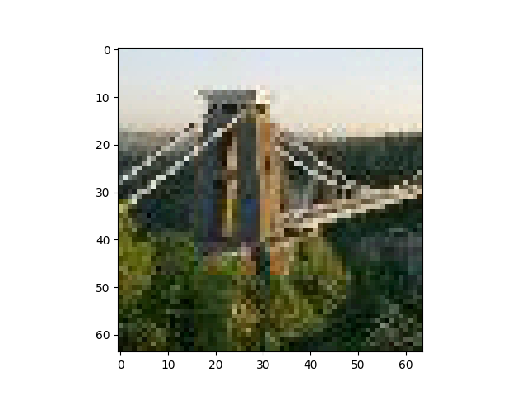




Visibility of attack with increasing Epsilon
E = 0.02
E = 0.1
E = 0.2
E = 0.5
E = 0.3

Slide 12
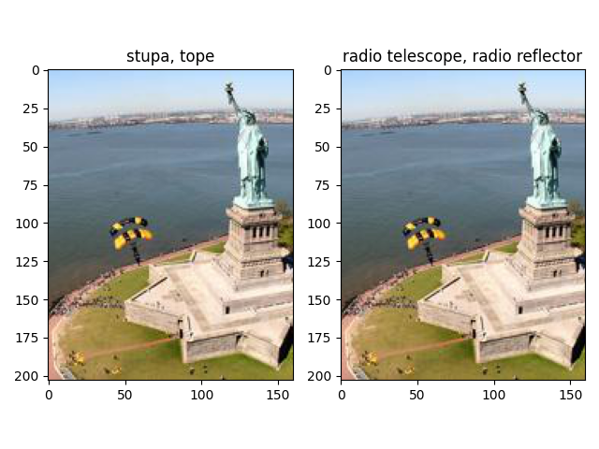
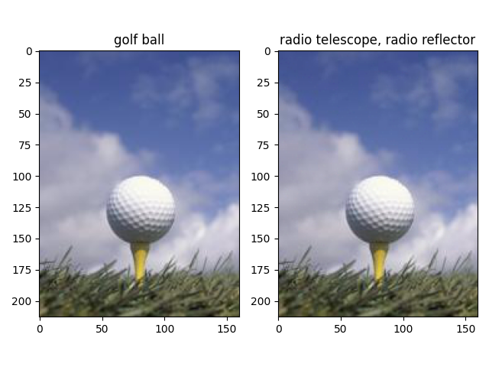
Untargeted attack on subset

Slide 13
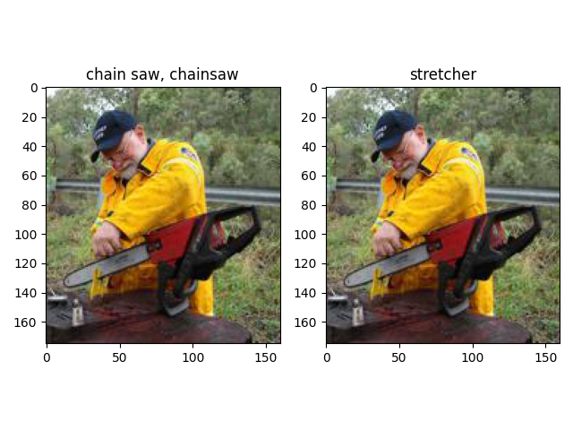
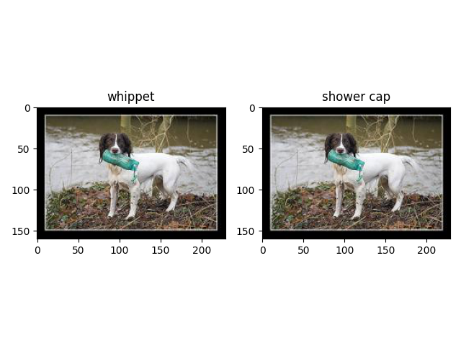
Untargeted attack on subset

Slide 14
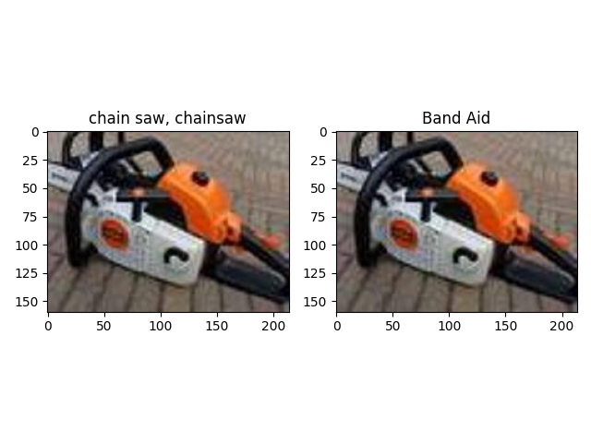
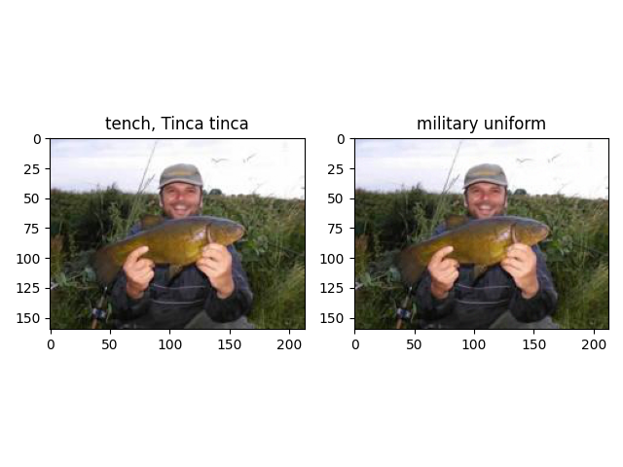
Target attack (epsilon=0.02) on subset

Slide 15
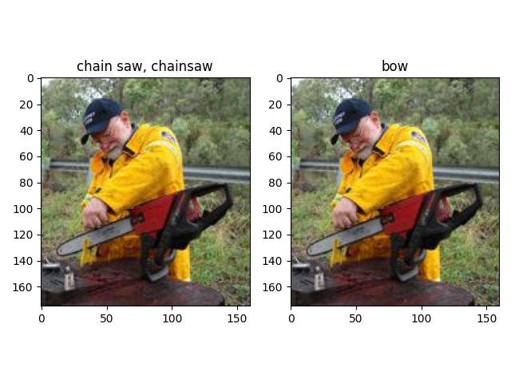
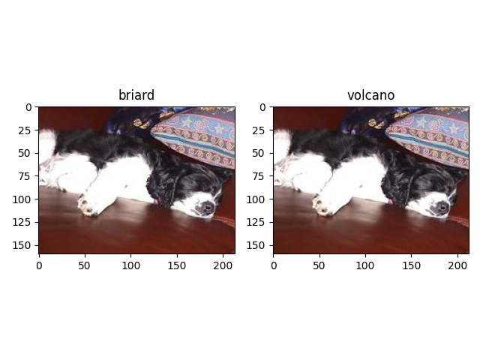
Target attack (epsilon=0.02) on subset

Slide 16
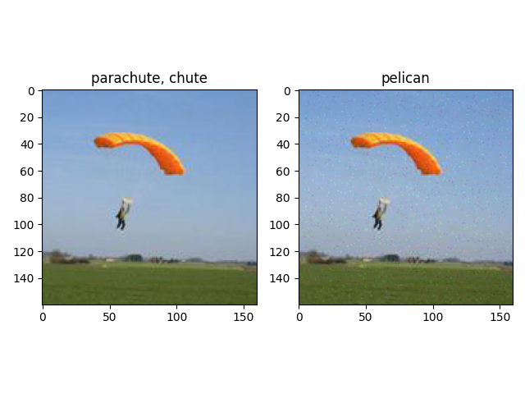
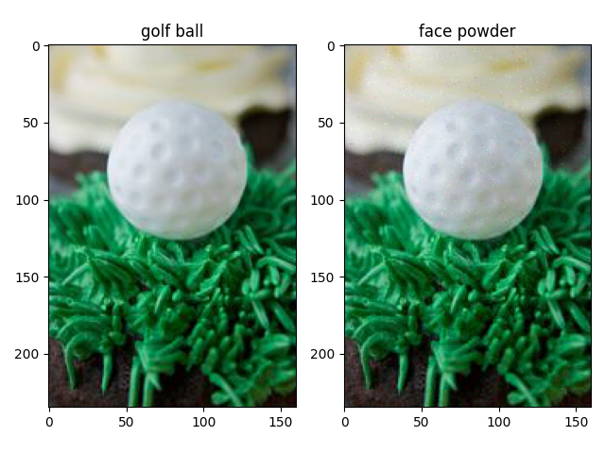
Target attack (epsilon=0.1) on subset

Slide 17
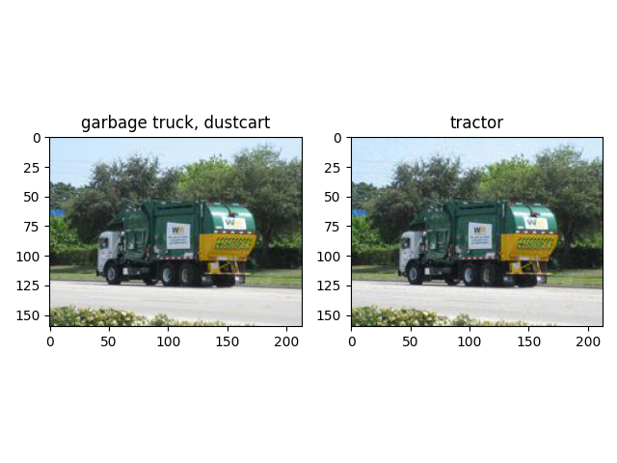
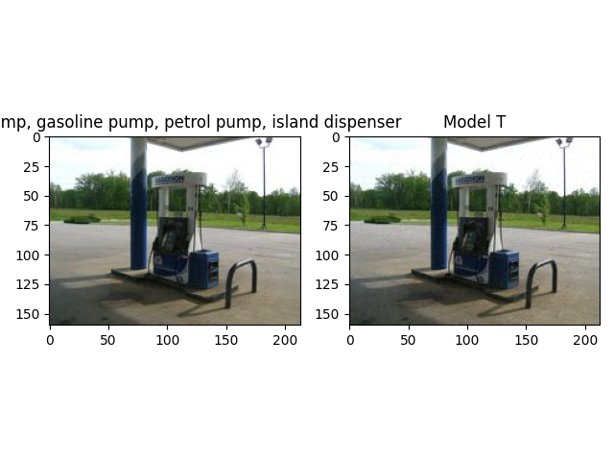
Target attack (epsilon=0.1) on subset

Slide 18
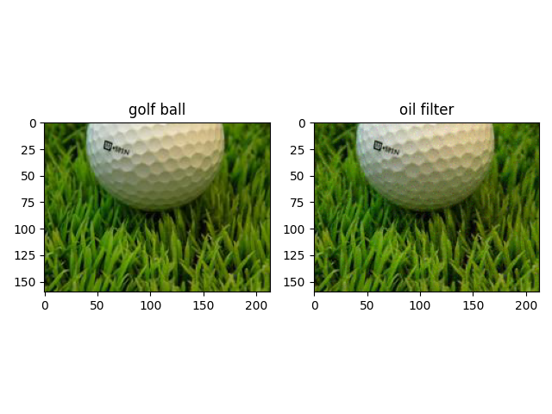
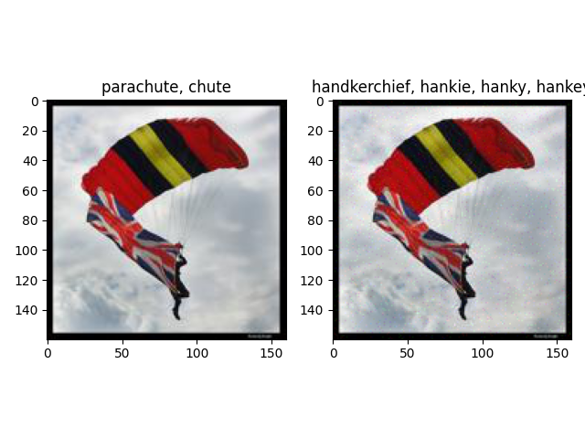
Target attack (epsilon=0.1) on subset

Slide 19
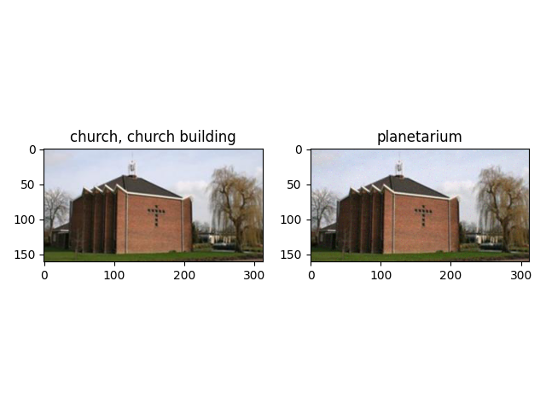
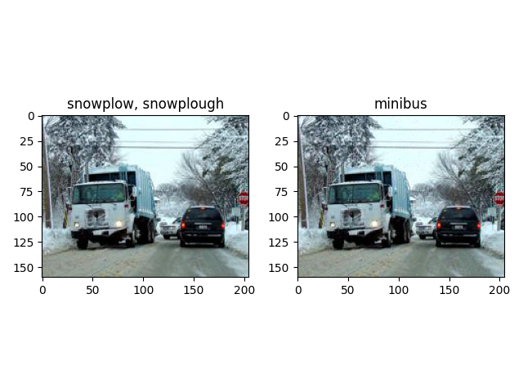
Target attack (epsilon=0.2) on subset

Slide 20
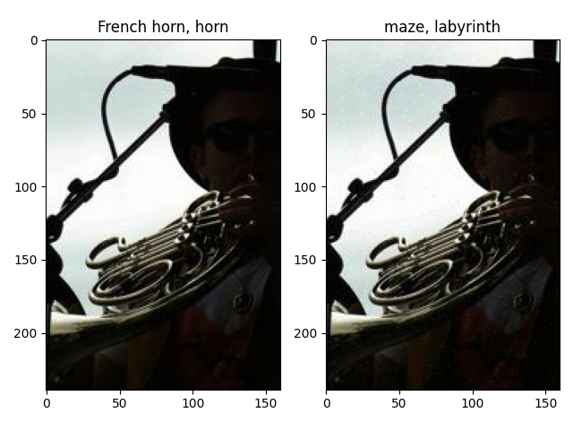
Target attack (epsilon=0.2) on subset

Slide 21
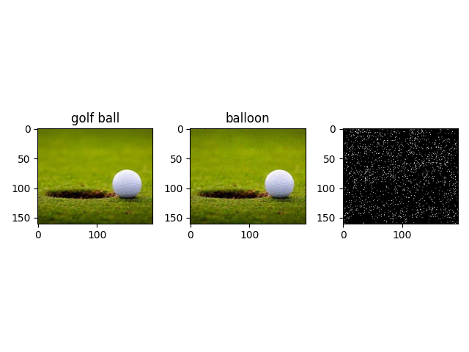
Visualization of pixel attack

Slide 22
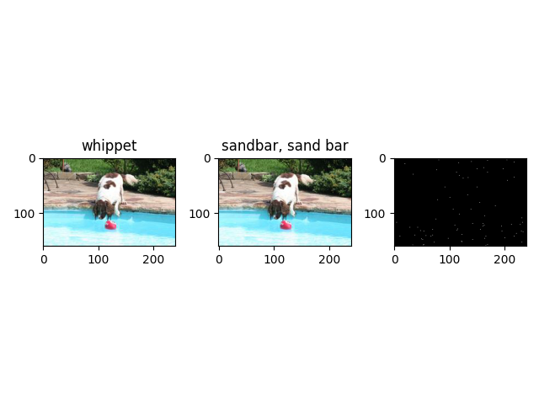
Visualization of pixel attack

Slide 23
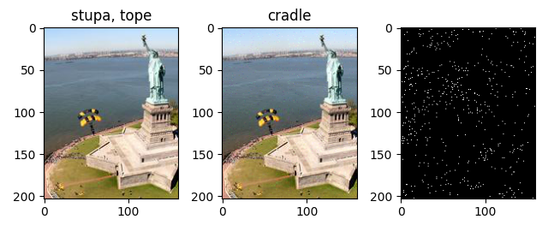
Visualization of pixel attack

Slide 24
Results on TinyImageNet (Untargeted Attack)
S.No | Epsilon | Attack Ratio | Avg. Iterations
1) | 0.02 | 1.0 | 505
2) | 0.1 | 1.0 | 126
3) | 0.2 | 1.0 | 58
4) | 0.3 | 1.0 | 39
5) | 0.5 | 1.0 | 24

Slide 25
Results on TinyImageNet (Targeted Attack)
S.No | Epsilon | Attack Ratio | Avg. Iterations
1) | 0.02 | 1.0 | 1331
2) | 0.1 | 1.0 | 294
3) | 0.2 | 1.0 | 162
4) | 0.3 | 1.0 | 120
5) | 0.5 | 1.0 | 79

Slide 26
Results on ImageNet Subset (Untargeted Attack)
S.No | Epsilon | Attack Ratio | Avg. Iterations
1) | 0.02 | 0.80 | 3126
2) | 0.1 | 0.97 | 1648
3) | 0.2 | 1.0 | 1240
4) | 0.3 | 1.0 | 945
5) | 0.5 | 1.0 | 658

Slide 27
Results on ImageNet Subset (Targeted Attack)
S.No | Epsilon | Attack Ratio | Avg. Iterations
1) | 0.02 | 0.53 | 5383
2) | 0.1 | 0.90 | 3383
3) | 0.2 | 0.96 | 2824
4) | 0.3 | 0.98 | 2636
5) | 0.5 | 1.0 | 2410

Slide 28
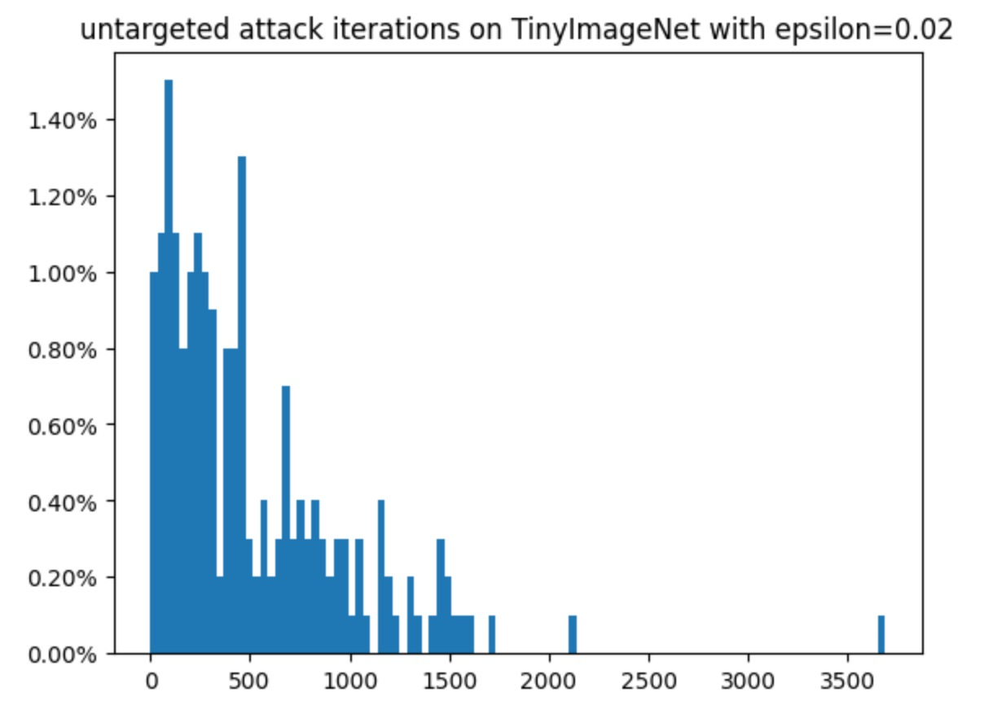
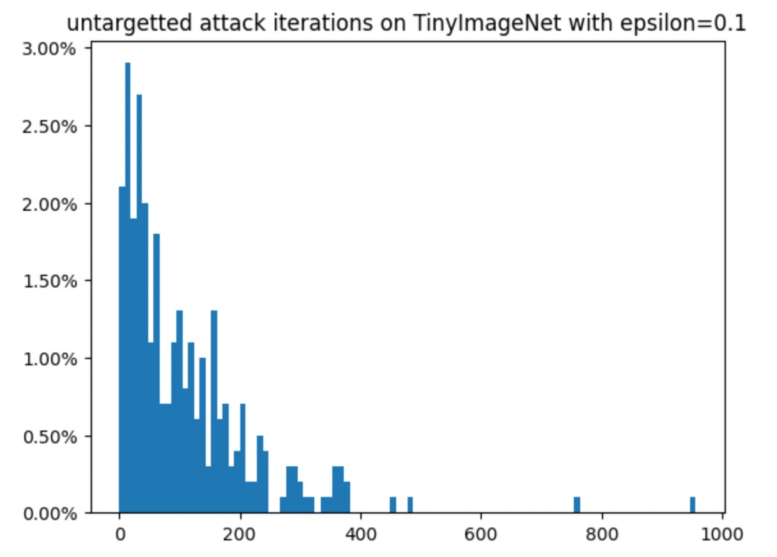
Distribution of untargeted attack iterations over images

Slide 29
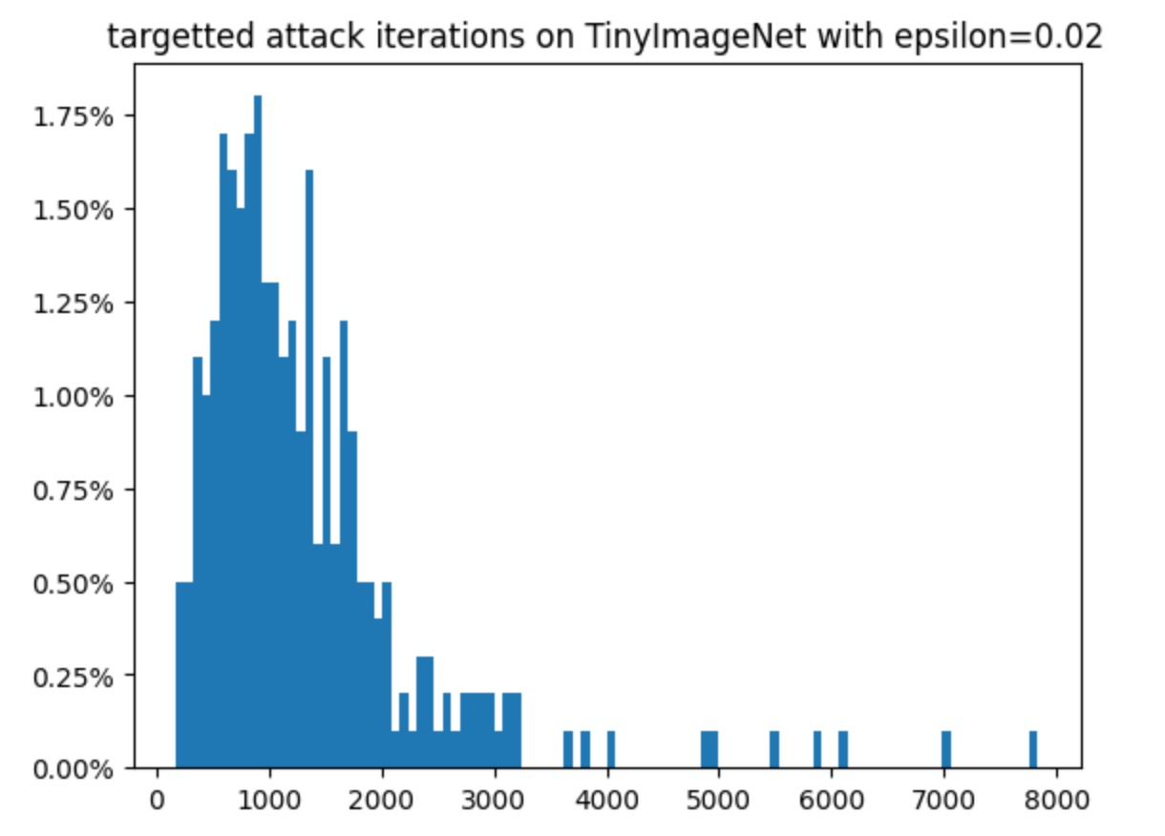
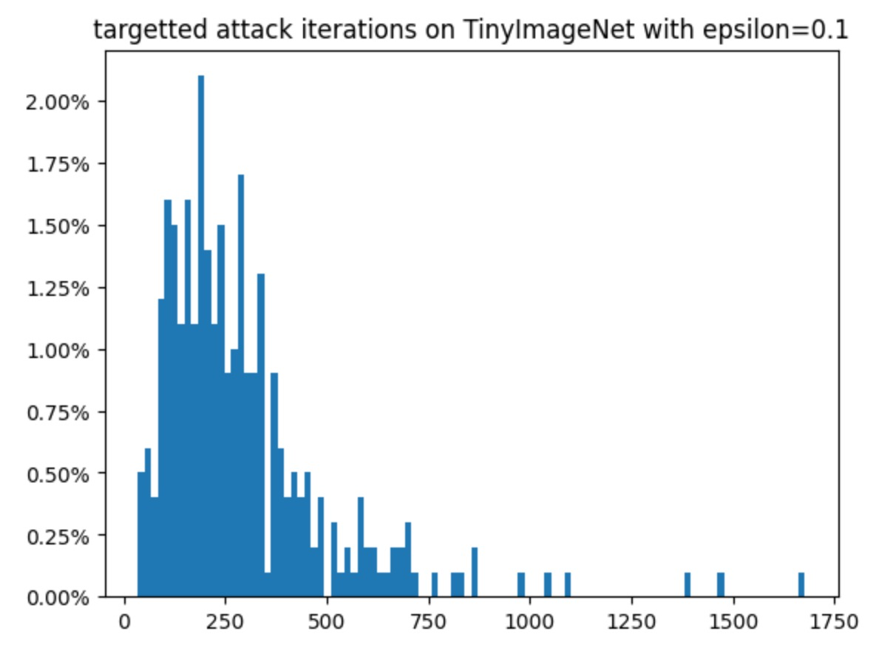
Distribution of targeted attack iterations over images

Slide 30
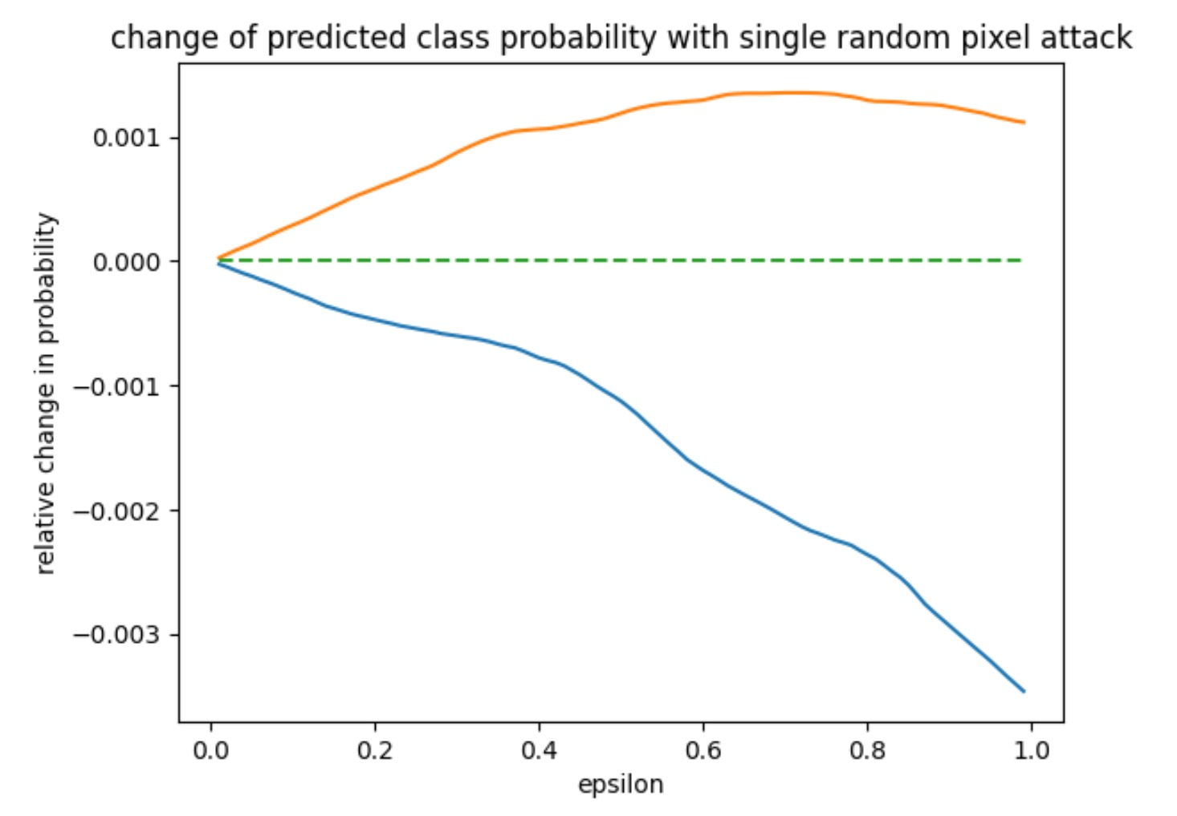

Slide 31
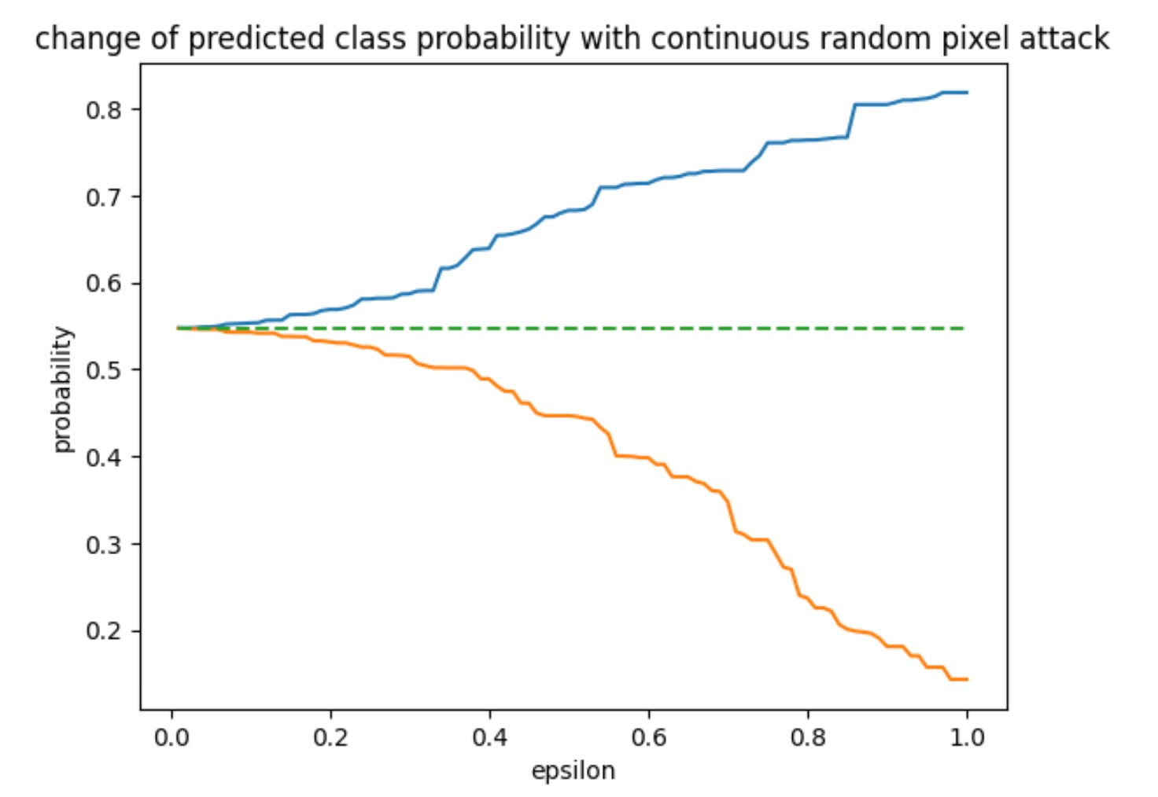

Slide 32
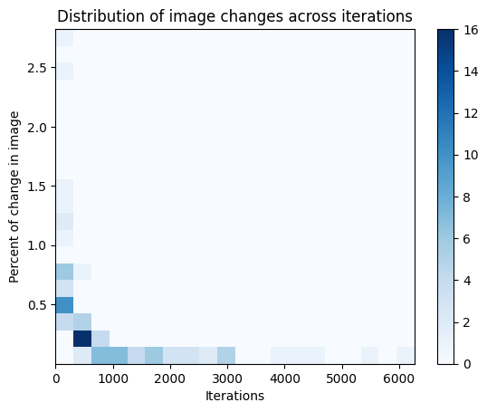
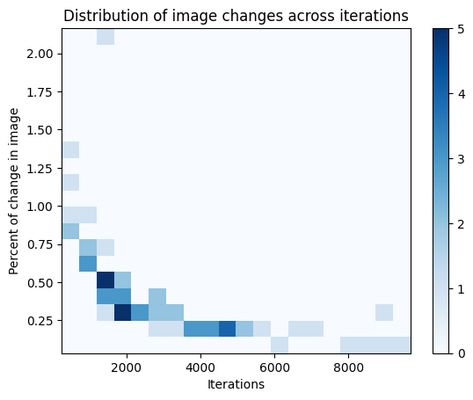
Untargeted attack, 100 images, eps=0.2
Targeted attack, 61 images, eps=0.2

Slide 33
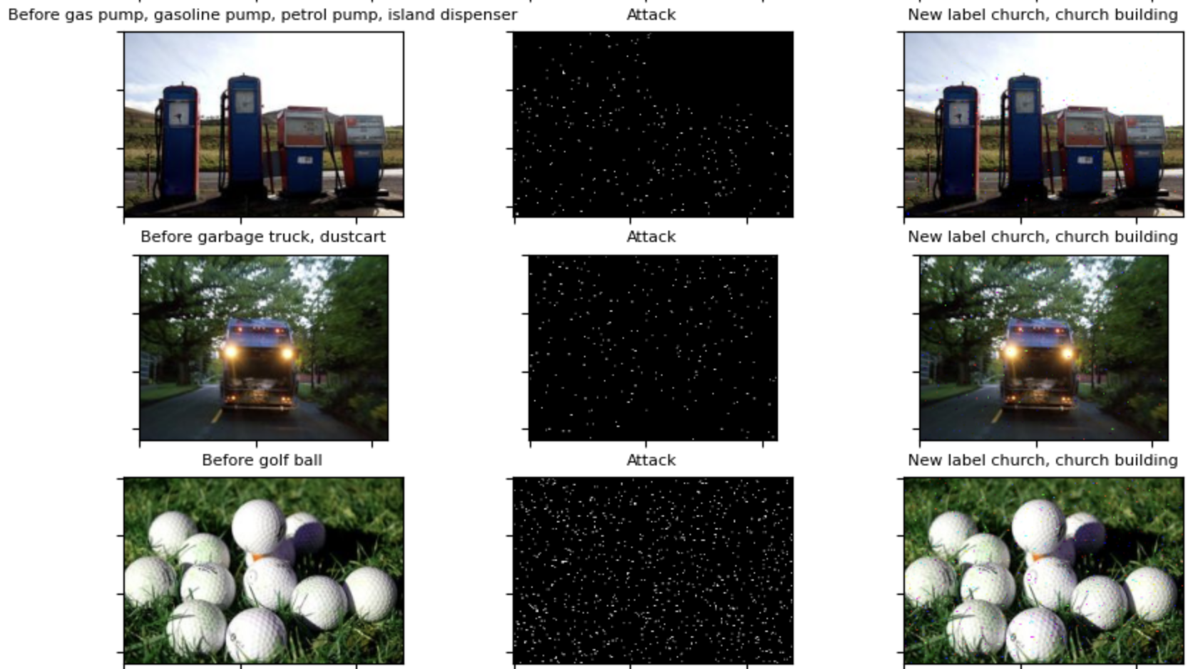
Improvements in strategy ~ <1000 iterations

Slide 34
Contribution:
Ardhendu Banerjee: Prepared the code for Black box pixel attack, extracted data subsets and label mappings for experimentation; conducted initial tests on multiple pretrained models for evaluating attack resistance v/s query time tradeoffs
Animesh Das: Compared various strategies for attack (localization) and conducted targeted attack visualization and performance tests; result compilation
Ritvik Gupta: Prepared code for attack on TinyImageNet and automated efficient runs for random image indices for tabulation and computation of success rate

Slide 35
Thank You

